Slide 1
House of Perfumes
By Ria Herwadkar
Notes:
This presentation will go over my design choices for my perfume e-commerce website. I will be explaining how each section was designed for usability, branding and responsiveness.

Slide 2
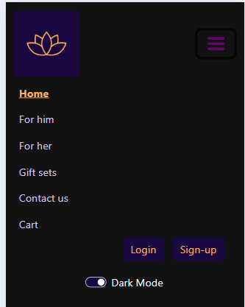

Navigation Bar: Desktop
Clean & Simple: White background blends into the page for a modern feel.
Logo Placement: Top left for brand recognition.
Easy Navigation: Key pages (For Him, For Her, Gifts, Cart, etc.) clearly visible.
Hamburger Menu (Mobile): Saves space for smaller screens.
Dark Mode Toggle: User-friendly for accessibility and aesthetics.
Notes:
The navigation was designed to be a clean and user-friendly, making it easy for users to explore the website. On desktops, the menu is fully visible for quick access, while on mobiles, a hamburger menu keeps the layout interface tidy. The dark mode toggle was included for accessibility and aesthetic purposes., ensuring the website maintains a sophisticated and visually appealing look in both light and dark mode. The golden yellow active state helps users identify their current page, while the pink hover effect provides visual feedback for interactions. The right-aligned login, sign-up, and dark mode toggle create a well-structured and balanced layout, ensuring clear spacing and easy access to essential features. Dark mode enhances readability in various lighting conditions, contributing to the overall sophisticated aesthetic.

Slide 3

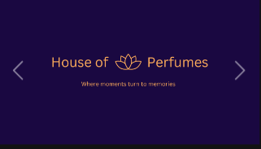
Carousel
Optimized for Mobile: Adapts images to different screen sizes for better viewing.
High-quality visuals: Reinforces the brand’s premium aesthetic.
Smooth transitions: Makes the experience more engaging.
Minimal text overlay: Keeps focus on visuals without overwhelming the design.
Notes:
The homepage carousel was designed to be visually immersive, reinforcing the brand’s luxurious feel. On desktop, full-width images create a high-end shopping experience, while on mobile, the layout adapts for optimal viewing. Smooth transitions enhance user experience by making navigation seamless, and minimal text overlay keeps the focus on the high-quality visuals without cluttering the design.

Slide 4

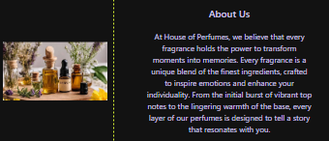
About us
Centered for Emphasis: Draws attention to the brand’s story.
Text & Image Balance: Creates a structured, easy-to-read layout.
Limited Text Length: Keeps it concise and engaging.
Neutral Background: Ensures readability without distractions.
Notes:
The About Us section is centered to ensure it stands out and captures attention. The combination of text and an image creates a balanced, structured layout, making it easy to read. Keeping the text concise prevents overwhelming the user while still sharing key brand details. The neutral background enhances readability and keeps the focus on the content.

Slide 5
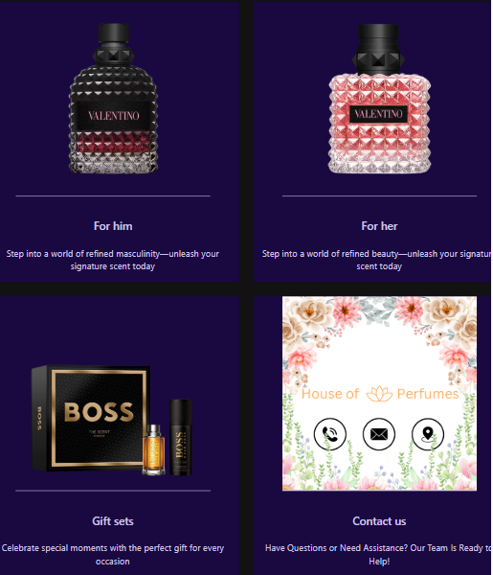
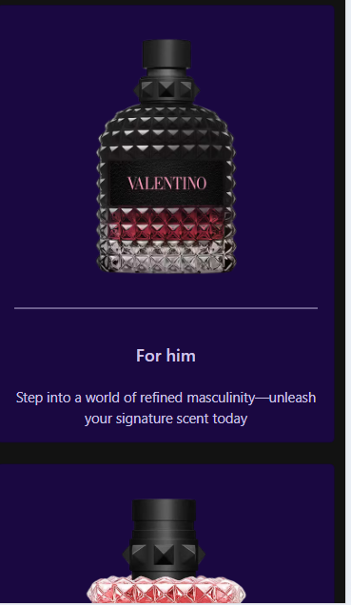
Menu Cards
Image-Based Navigation: Makes browsing categories intuitive.
Consistent Card Sizing: Maintains a uniform, clean look.
Minimal Text: Keeps the focus on visuals for quick decision-making.
Notes:
The menu cards were designed to offer a simple and visual way to navigate different product categories. The consistent card sizing ensures a clean and structured look, while minimal text keeps the focus on the product images. This approach makes browsing intuitive, allowing users to quickly find the category they’re interested in.

Slide 6

Footer
Dual footer system: One for the main site, another for login and signup pages.
Main footer: Provides quick access to essential policies (GDPR, PETA, IFRA, etc.), ensuring transparency.
Legal and location links: Helps users easily find store details and understand brand commitments.
Dark background: Enhances readability and aligns with dark mode aesthetics.
Evenly spaced links: Ensures a clean, uncluttered look for easy navigation.
Login/signup footer: Minimal design keeps focus on form completion with fewer distractions.
Consistent branding: Matches the overall theme while keeping the interface user-friendly.
Notes:
The main footer is designed for accessibility, providing quick access to policies and legal information while maintaining a clean, structured layout. The login/signup footer is intentionally minimalistic, reducing distractions to help users focus on filling out forms. Both footers use a dark background for readability and aesthetic consistency across the website.

Slide 7
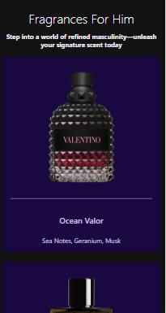
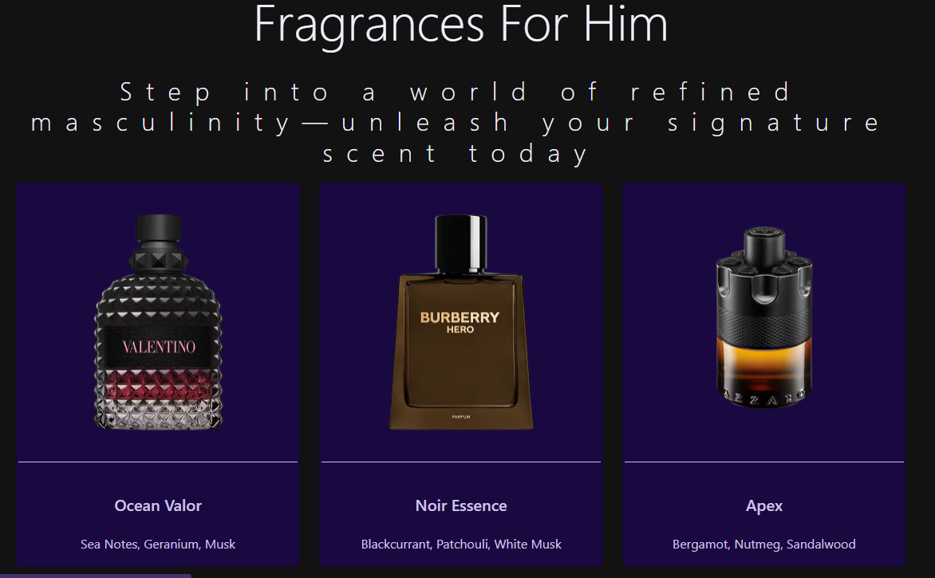
Product Listings
Grid Layout: Organizes products neatly, making them easy to browse.
Consistent Image Sizes: Maintains a professional and uniform look.
Product Titles & Notes: Gives users quick, relevant information.
Notes:
The grid layout was chosen to present products in a structured and visually appealing way, making them easier to browse through. Having consistent image sixes maintain a professional and organised look across the page. The product titles and scent notes help users quickly identify key information without needing to click into each product.

Slide 8
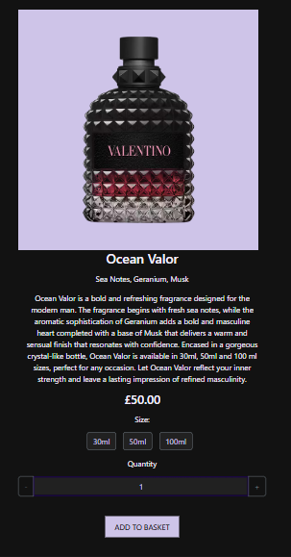
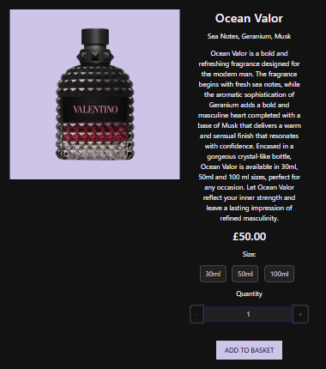
Product Individual Page
Large Product Image: Keeps focus on the product, reinforcing a premium shopping experience.
Clear Hierarchy: Product name, description, and price are displayed prominently for easy readability.
Size Selection Buttons: Allows users to choose different product sizes conveniently.
Quantity Selector: Provides a smooth way to adjust the number of items before adding to the cart.
Consistent Dark Mode Support: Ensures readability and maintains aesthetic appeal across themes.
Add to Basket Button: Stands out for clear visibility, encouraging easy purchasing.
Notes:
The large product image is the focal point, helping users see the fragrance design in detail. A clear information structure ensures the product name, description and price are easy to read. The size selection and quantity options provide flexibility, improving the shopping experience. The add to basket button is prominent, making it easy for users to proceed with their purchase.

Slide 9
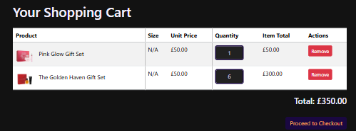
Cart
Table Layout for Clarity: Organizes product details like name, size, price, quantity, and total cost in a structured format.
Quantity Adjustment: Allows users to modify the number of items directly within the cart.
Remove Button: Ensures users can easily remove unwanted items.
Total Price Display: Provides a clear summary of the total cost before checkout.
Proceed to Checkout Button: Stands out for easy navigation to the next step.
Notes:
The table layout keeps the cart organized, allowing users to see all essential details .The quantity adjustment and remove button improve usability, making it easy to manage items before checkout. A clear total price display helps users keep track of costs, while the prominent checkout button guides them to the final purchase stage effortlessly.

Slide 10
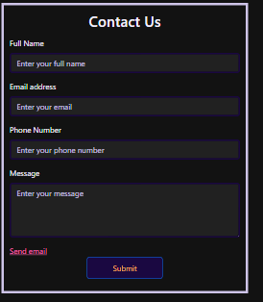
Contact Us Form
Minimalist Design: Keeps the form clean and easy to read.
Centered Layout: Draws focus to the form, making it the main point of interaction.
Soft Background Contrast: Ensures readability while maintaining aesthetics.
Clear Field Labels: Helps users understand where to input their details.
Consistent Button Styling: Matches the overall website design for visual cohesion.
Spacing Between Elements: Prevents a cluttered appearance and improves usability.
Notes:
The Contact Us Form follows a clean and straightforward design to enhance usability. The centered layout draws attention to the form. The soft background contrast enhances text visibility without straining the eyes. Well-labeled fields make filling out the form intuitive, and the styled submit button keeps branding consistent. Proper spacing between form elements improves the overall user experience by maintaining a neat and organized appearance.

Slide 11
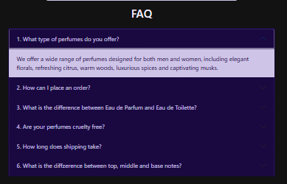
FAQ
Accordion Format: Keeps the page clean and organized by collapsing answers.
Expandable Questions: Allows users to access only the information they need.
Consistent Styling: Matches the rest of the website’s design for cohesion.
Centered Layout: Ensures a balanced and structured appearance.
Notes:
The FAQ section was designed using an accordion format to keep the page organized and clutter-free. Users can expand only the questions they need, making it easier to find relevant information. The consistent styling aligns with the website’s overall aesthetic, ensuring a seamless experience. A centered layout keeps the section structured, while dark mode compatibility enhances readability across different lighting conditions.

Slide 12
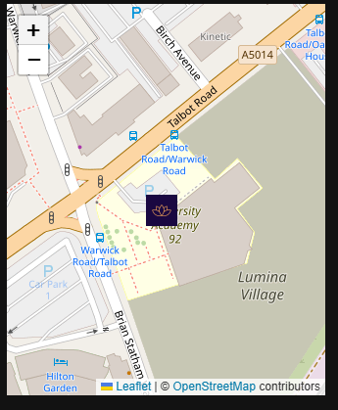
Interactive Map
Interactive Map: Allows users to zoom and move the map for better navigation.
Custom Marker: Highlights the store’s exact location for clear identification.
Minimalist Design: Keeps the focus on usability without unnecessary distractions.
Notes:
The map is fully interactive, allowing users to zoom and move for better navigation. A custom marker featuring the website’s logo highlights the store’s exact location, making it easy to identify. The design remains minimalist, keeping the focus on functionality.

Slide 13
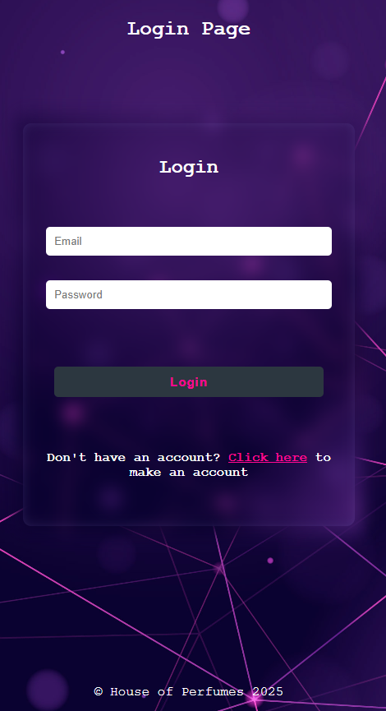
Login Form
Minimalist Layout: Keeps the focus on logging in.
Blurred Background Effect: Enhances readability while maintaining a modern aesthetic.
Centered Form: Ensures a structured and balanced look.
Protected Password: Improves security without affecting design clarity.
Small Footer: Reduces unnecessary elements to keep the design clean
Notes:
The login form was designed to be minimalist and user-friendly, ensuring users can log in without distractions. The blurred background effect keeps the form readable while maintaining a modern, sleek look. The form is centered, creating a structured and visually balanced layout. Having a protected password is included for security, but its design remains clear and non-intrusive. The small footer keeps the page clean, preventing unnecessary distractions from the login process.

Slide 14
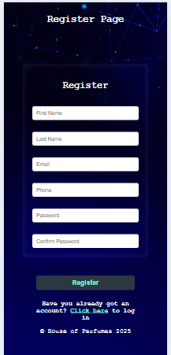
Register Form
Structured & Balanced Layout: Keeps fields organized for readability.
Blurred Background Effect: Improves focus on the form while maintaining aesthetics.
Consistent Input Field Styling: Creates a uniform and professional look.
Password & Confirm Password Fields: Ensures clarity in form completion.
Spacing Between Fields: Prevents clutter and enhances readability.
Minimal Footer: Maintains focus on the registration process.
Notes:
The register form was designed to be structured and easy to navigate, ensuring a smooth user experience. A blurred background effect was used to keep the form readable while maintaining an aesthetically pleasing design. Consistent input field styling ensures a professional and cohesive appearance. Password and confirm password fields are clearly separated, reducing confusion. Sufficient spacing between form elements prevents visual clutter, making the form easier to fill out. The minimal footer ensures the user's attention remains on completing their registration.

